Slide 1

VoiceFirst
CASE STUDY
How VoiceFirst Helps Management Understand Employee Workplace Concerns Early
Workplace Concern
Voice
Photo
Video
Text
Early visibility. Better workplace decisions.
A management case study on using closed, real-time reporting to understand workplace concerns, identify patterns, and improve organizational accountability.
Closed System
01
Every issue. One database. Zero blind spots.

Slide 2
VoiceFirst
Executive Summary
Workplace concerns become easier to manage when they are visible early.
The situation
The VoiceFirst role
The outcome
Many workplace concerns are shared late, filtered through layers, or lost in informal conversations.
Employees and teams can report concerns through a private, closed system using voice, photo, video, or text.
Management gets early signals, pattern visibility, and a central record to support better workplace decisions.
VoiceFirst helps move management from delayed awareness to early action.
02
Every issue. One database. Zero blind spots.

Slide 3
VoiceFirst
Background: The Internal Blind Spot
Formal reports rarely show the full ground-level workplace reality.
What management usually sees
What may stay hidden
• Reports
• Meetings
• Supervisor updates
• Dashboards
• Performance numbers
• Behaviour concerns
• Communication gaps
• Safety observations
• Favoritism signals
• Repeated process delays
?
The gap between formal updates and ground truth creates management blind spots.
03
Every issue. One database. Zero blind spots.

Slide 4
VoiceFirst
The Challenge
Concerns are often delayed, filtered, or never recorded.
Comfort to report
Scattered channels
Employees may hesitate to raise concerns directly.
Issues get lost across calls, chats, and informal conversations.
Filtered updates
No pattern view
Management may receive only polished or incomplete information.
Repeated concerns are difficult to identify without one database.
Result: small workplace concerns can quietly become larger operational challenges.
04
Every issue. One database. Zero blind spots.

Slide 5
VoiceFirst
The Objective
Create a private, structured way to understand concerns early.
1
2
3
4
5
Capture concerns
without friction
Route to the
right authorized person
Track every issue
until resolution
Identify repeated
patterns early
Build one central
knowledge record
Goal: early visibility, responsible action, and better workplace decisions.
05
Every issue. One database. Zero blind spots.

Slide 6
VoiceFirst
VoiceFirst Solution
A closed system for reporting, routing, tracking, and learning.
Report
Classify
Route
Track
Voice
Photo
Video
Text
Department
Issue type
Priority
Status
Authorized
person +
supervisor
Action
Resolution
Record
Closed visibility: only authorized people see the report.
06
Every issue. One database. Zero blind spots.

Slide 7
VoiceFirst
Example Scenario
Repeated staff behaviour concern handled through a structured process.
The situation
VoiceFirst Concern Record
An employee notices repeated harsh communication inside a team. Previously, it may have stayed informal or never reached management clearly.
Category
Workplace Concern
Issue Type
Staff Behaviour
Department
Operations
Priority
Medium
Status
Submitted → Reviewed → Resolved
If similar concerns repeat, management can identify the pattern early.
07
Every issue. One database. Zero blind spots.

Slide 8
VoiceFirst
Issue Journey: Before vs After
VoiceFirst turns informal signals into a clear resolution path.
Before VoiceFirst
After VoiceFirst
Concern happens
↓
Employee hesitates or shares verbally
↓
Information may be filtered or lost
↓
Management learns late or not at all
Concern happens
↓
Employee reports privately
↓
Issue is classified and routed
↓
Resolution and pattern are visible
08
Every issue. One database. Zero blind spots.

Slide 9
VoiceFirst
Management Insights & Impact
Every report becomes workplace intelligence.
Employee performance
Safe workplace
Identify strong performers and teams that need support.
Create a transparent channel for sensitive concerns.
Operational risk
Knowledge repository
Spot repeated risks before they grow.
Keep one record of every concern, action, and resolution.
Outcome: better accountability, better decisions, and a stronger organization.
09
Every issue. One database. Zero blind spots.

Slide 10
VoiceFirst
VoiceFirst
Early visibility.
Better workplace decisions.
VoiceFirst helps management understand employee workplace concerns early, identify patterns, and build a more transparent organization.
Capture
Route
Learn
voice • photo • video • text
right person + supervisor
patterns + reports + records
Every issue. One database. Zero blind spots.
Book a demo / See it working on your own scenario
10
Every issue. One database. Zero blind spots.

Slide 11
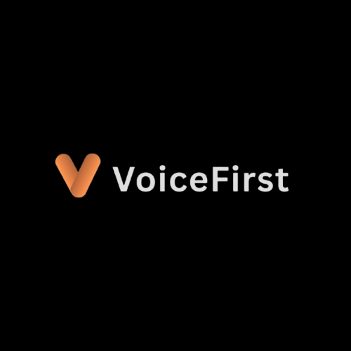
VoiceFirst. Every issue. One database. Zero blind spots.
VoiceFirst for Businesses
How daily issues become operational intelligence and continuous improvement.
Contact Us: 8943440101
Visit Our Website: https://voicefirst.io/
Email: sales@notetech.com

