Slide 1

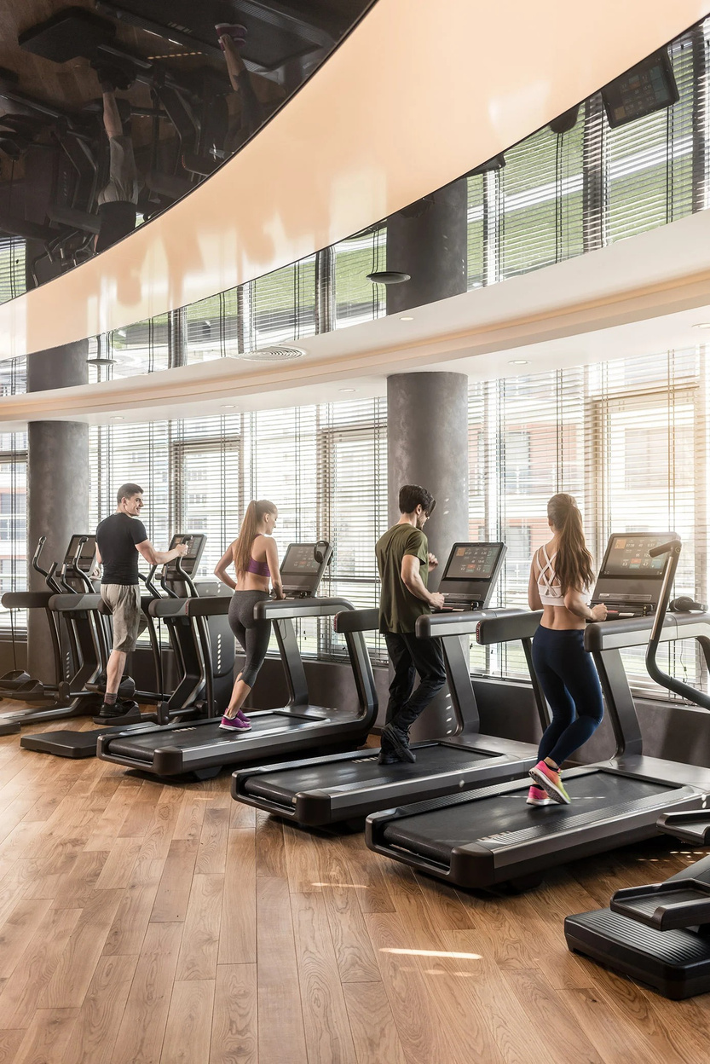
V
VoiceFirst
01
FOR FITNESS CENTRES
CASE STUDY
VoiceFirst for Fitness Centres
How daily issues become operational intelligence and continuous improvement.
ActiveLife Fitness
12 centres · 85 staff · 18,000 members
Member Experience
Safety
Operations
Retention
Fitness Centre Case Study

Slide 2
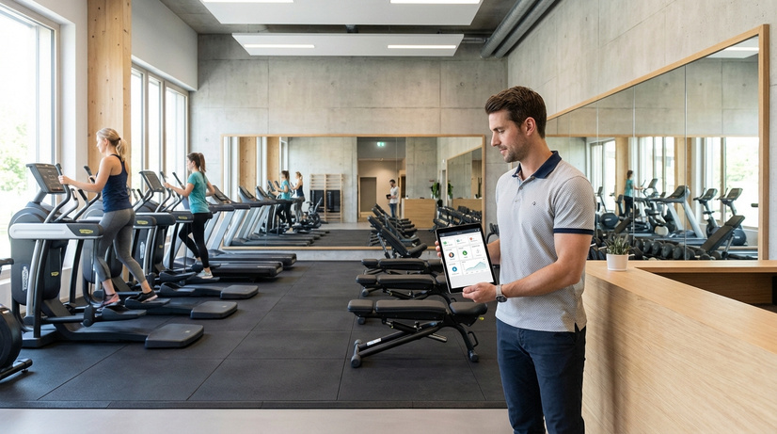
V
VoiceFirst
02
FOR FITNESS CENTRES
BUSINESS SCENARIO
A growing fitness brand with daily operational complexity
Management tracks memberships, revenue and attendance — but the real experience happens across the club floor every day.
🏢
12 Fitness Centres
👥
85 Staff Members
📈
18,000 Members
📍
Many Zones
Trainers, front desk, maintenance, housekeeping and managers.
Thousands of daily interactions and service moments.
Gym floor, classes, lockers, reception and wellness areas.
Multiple locations, each with its own member experience.
The business context

Slide 3
V
VoiceFirst
03
FOR FITNESS CENTRES
BEFORE VOICEFIRST
The issue was not care. It was capture.
Small operational issues became bigger business problems.
Issues were scattered across front-desk conversations, WhatsApp messages, shift notes and meetings. Some were solved. Some were forgotten.
💬
Scattered Channels
❓
No Clear Owner
🔁
Repeated Issues Hidden
👁️
Management Blind Spots
Calls, chats, verbal updates and paper notes created fragmented visibility.
Teams were unsure who should act, track and close an issue.
The same complaints happened again, but patterns were hard to see.
Leadership saw outcomes, not daily causes behind them.
The blind spot

Slide 4
V
VoiceFirst
04
FOR FITNESS CENTRES
WHAT IT CAPTURES
Everything that matters inside a fitness centre
VoiceFirst captures member issues, staff observations, safety risks and improvement ideas in one place.
🏋️
Equipment
🧼
Cleanliness
⭐
Member Experience
Broken treadmills, damaged benches, missing weights
Locker rooms, showers, wet floors, odour
Billing confusion, trainer feedback, access issues
🛡️
Safety & Risk
⚙️
Staff & Process
💡
Suggestions
Slippery floors, unsafe equipment, blocked exits
Shift delays, training gaps, ownership issues
Ideas that improve service, speed and retention
One place for every issue

Slide 5
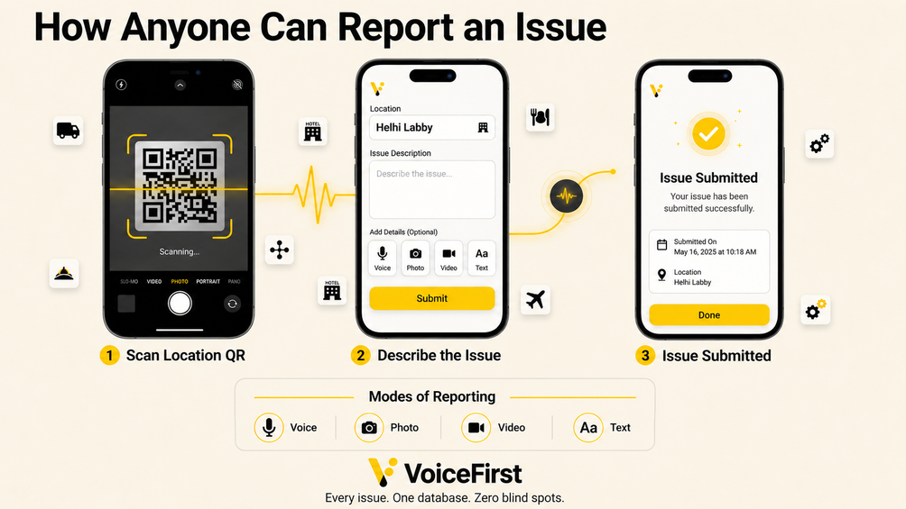
V
VoiceFirst
05
FOR FITNESS CENTRES
HOW VOICEFIRST WORKS
Report. Route. Resolve. Learn.
Members and staff can report in seconds using voice, photo, video or text.
①
Report
②
Classify
Member or staff flags an issue.
Branch, type and priority are organized.
③
Route
④
Resolve
Right person and supervisor receive it.
Tracked until it is closed.
Register once, report in seconds

Slide 6
V
VoiceFirst
06
FOR FITNESS CENTRES
EXAMPLE WORKFLOW
Broken treadmill becomes a trackable action
A member reports a treadmill that stops suddenly during use and attaches a short video.
Issue Reported
Assigned
In Progress
Resolved
→
→
→
Video + text from member
Branch manager + maintenance
Repair and testing
Status updated and closed
Management learns: category, branch, resolution time, frequency of similar complaints and maintenance response speed.
From one complaint to operational learning

Slide 7
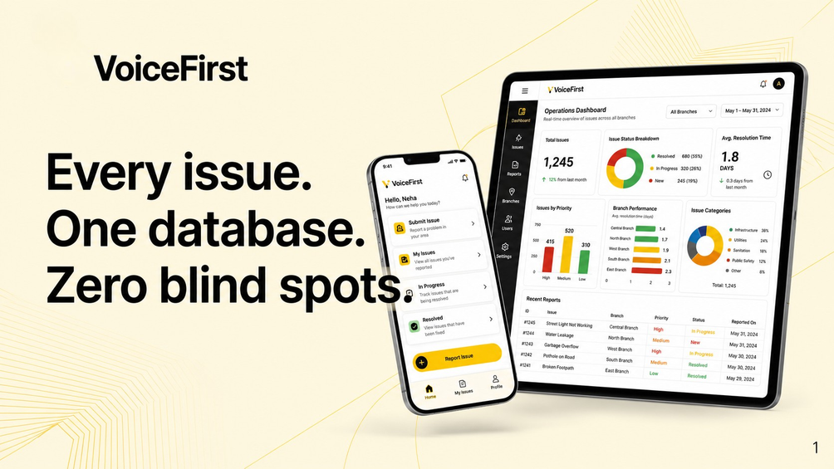
V
VoiceFirst
07
FOR FITNESS CENTRES
MANAGEMENT VISIBILITY
From guessing to knowing
VoiceFirst helps leadership understand what is happening across clubs, teams, facilities and time periods.
🔧
Equipment fails most often
⏱️
Slowest resolution branches
Identify repeated machine issues.
Support weaker clubs faster.
🔁
Recurring complaints
🛡️
Safety risks
Detect patterns before churn.
Act before incidents happen.
Operational intelligence dashboard

Slide 8
V
VoiceFirst
08
FOR FITNESS CENTRES
OPERATIONAL INTELLIGENCE
A dashboard that shows the health of every club
Instead of only seeing sales and cancellations, management can see the operational signals behind them.
Total Issues
Avg Resolution
Top Category
Participation
1,248
1.8 days
Equipment
68%
reported this month
from submit to close
32% of reports
staff + member reports
🔥
Risk Heat Map
📊
Branch Health Score
💡
Improvement Opportunities
Where safety and maintenance risks are increasing.
Compare clubs side by side.
Turn repeated issues into action.
This is operational intelligence

Slide 9
V
VoiceFirst
09
FOR FITNESS CENTRES
KAIZEN ANGLE
Every report becomes an improvement signal
Fitness centres improve through small, daily fixes: cleaner spaces, safer equipment, faster responses and better service habits.
Report
Pattern
Action
Improve
→
→
→
Member or staff shares the signal
VoiceFirst reveals repetition
Team fixes root cause
Club experience gets better
Kaizen is the mindset. VoiceFirst is the system that makes continuous improvement visible, trackable and measurable.
Continuous improvement

Slide 10
V
VoiceFirst
10
FOR FITNESS CENTRES
BUSINESS IMPACT
Better member experience. Safer clubs. Stronger retention.
VoiceFirst helps fitness centres listen better, respond faster and improve every day.
😊
Member Experience
⚡
Faster Resolution
🛡️
Safer Environment
Members feel heard when issues are captured and tracked.
Issues reach the right owner quickly.
Risks are reported early before they grow.
📍
Branch Accountability
🤝
Member Retention
Management sees which clubs respond faster.
Recurring problems are fixed before they cause churn.
VoiceFirst. Every issue. One database. Zero blind spots.
Book a demo

Slide 11
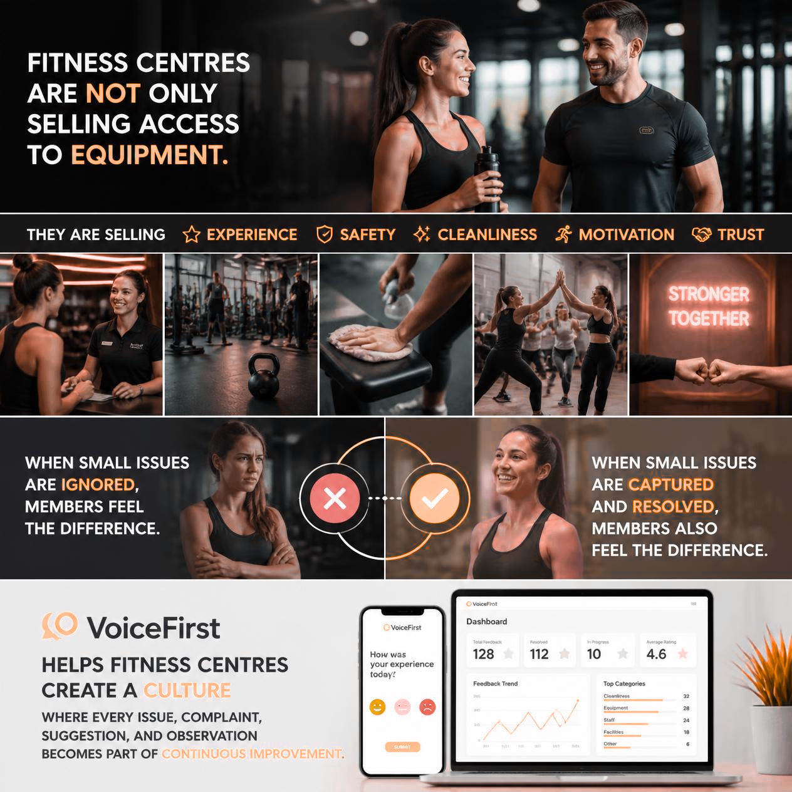

V
VoiceFirst
FOR FITNESS CENTRES
VoiceFirst. Every issue. One database. Zero blind spots.
Book a demo

Slide 12
V
VoiceFirst. Every issue. One database. Zero blind spots.
VoiceFirst for Fitness Centres
How daily issues become operational intelligence and continuous improvement.
Contact Us: 8943440101
Email: sales@notetech.com

Slide 13

VoiceFirst. Every issue. One database. Zero blind spots.
VoiceFirst for Fitness Centres
How daily issues become operational intelligence and continuous improvement.
Contact Us: 8943440101
Email: sales@notetech.com

